Slide 1

OOAD Project
ArogyaDost

Slide 2
Team Member
Hitesh Dhiman -22114036
Mail Id: hitesh_d@cs. iitr.ac.in
Contact no: 8580558575
Contribution: Backend and AI training
Indranil Das-22114037
Mail id:indranil_d@cs.iitr.ac.in
Contact no:-8902031812
Contribution:- AI training and dataset collection
Kakumani Kushalram- 22114043
Mail id: kakumani_k@cs.iitr.ac.in
Contact no:-7801032609
Contribution:- Backend
Piyush Gokul Chavan-22114024
Mail id:chavan_pg@cs.iitr.ac.in
Contact no:-9422900151
Contribution:- Frontend and Backend
Nithin Nathanael.B -22114023
Mail id:bolapati_nn@cs.iitr.ac.in
Contact no:-9393997777
Contribution:- Frontend
Sadineni Chaitanya -22114082
Mail id: sadineni_c@cs.iitr.ac.in
Contact no:-9381194628
Contribution:- Frontend

Slide 3

Introduction and project description
In the realm of mental health, access to immediate and accurate information is crucial for those seeking guidance and support. Our Mental Health FAQ Chatbot serves as a reliable and empathetic virtual assistant, designed to address common queries and concerns related to mental health. By providing accessible and informative responses, our chatbot aims to promote awareness, reduce stigma, and encourage users to take proactive steps towards better mental well-being.
Our Mental Health FAQ Chatbot is a user-friendly and interactive platform that specializes in answering frequently asked questions regarding mental health. Through a carefully curated database and advanced natural language processing capabilities, the chatbot can provide prompt and accurate responses to a wide range of inquiries. Users can easily access the chatbot through various digital platforms, ensuring convenient and confidential access to information from the comfort of their own devices.

Slide 4
Implementation and Tech Stacks Used​
HTML, CSS, and JavaScript, Bootstrap for the frontend, crafting the user interface and experience.
Python as the backend language, along with Django as the framework, managing server-side operations and application logic.
Chatterbot, a Python library, integrated for intelligent chat functionalities, enhancing user interaction.
Default SQLite3 used for the database, storing and managing application data and user information.

Slide 5
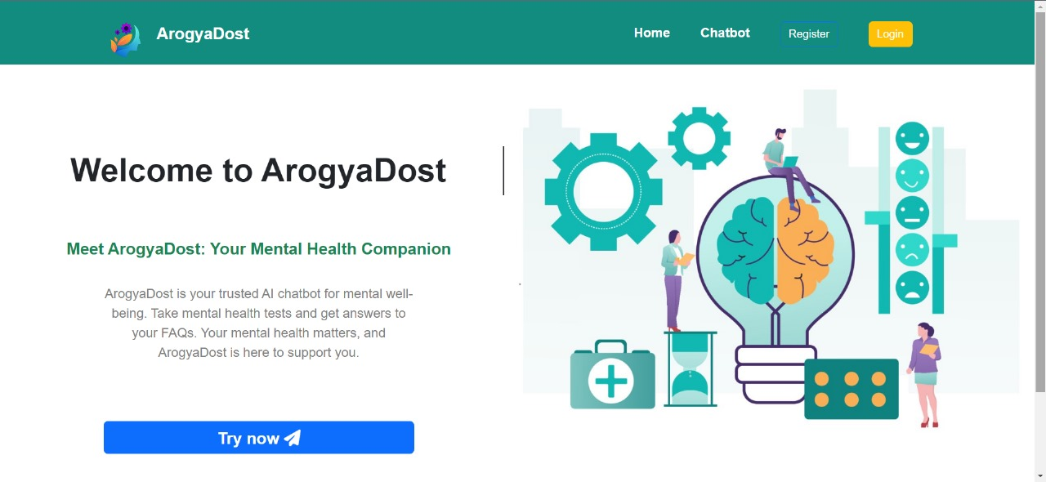
Home Page
The home page features main distinct buttons:
Register: For new users to create personalized accounts.
Login: To quickly access existing accounts and personalized dashboards.
Try as Guest User: For anonymous use, ensuring confidentiality without the need for registration.
Chatbot: It has same function as try as Guest User.

Slide 6
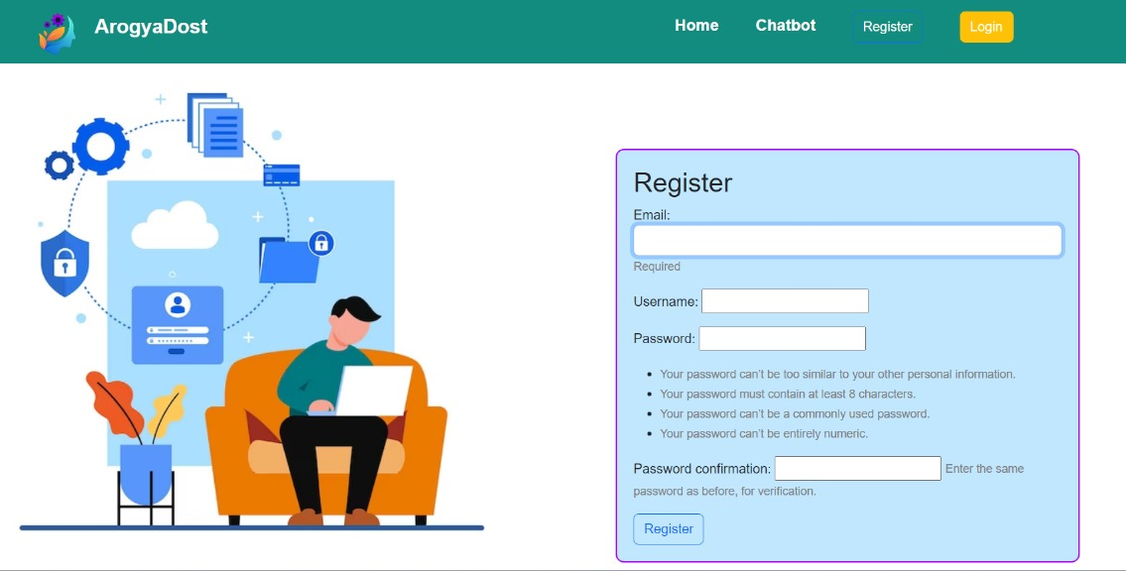
Register Page
You will be redirected to this page after you click the register button on the home page.
To register, please provide your email and name, and create a password. You will need to re-enter the password to confirm it.
Upon registration, you will be directed to the chat page, allowing you to begin interacting with the chatbot.

Slide 7
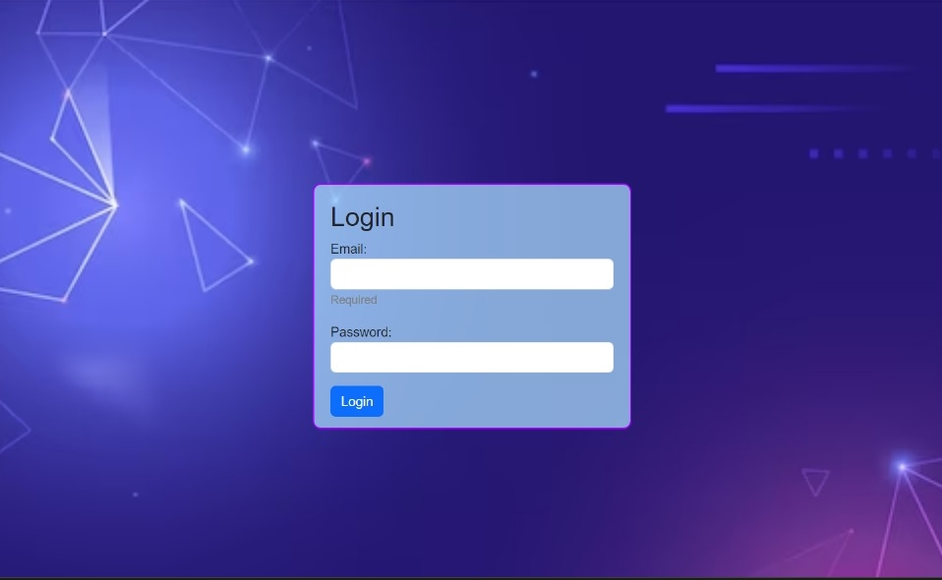
Login Page
Users can log in by providing their email and password.
Once you've entered the correct details, you'll be directed to the chat page.
In the case of incorrect details, the password field will be cleared, requiring you to re-enter your information.

Slide 8
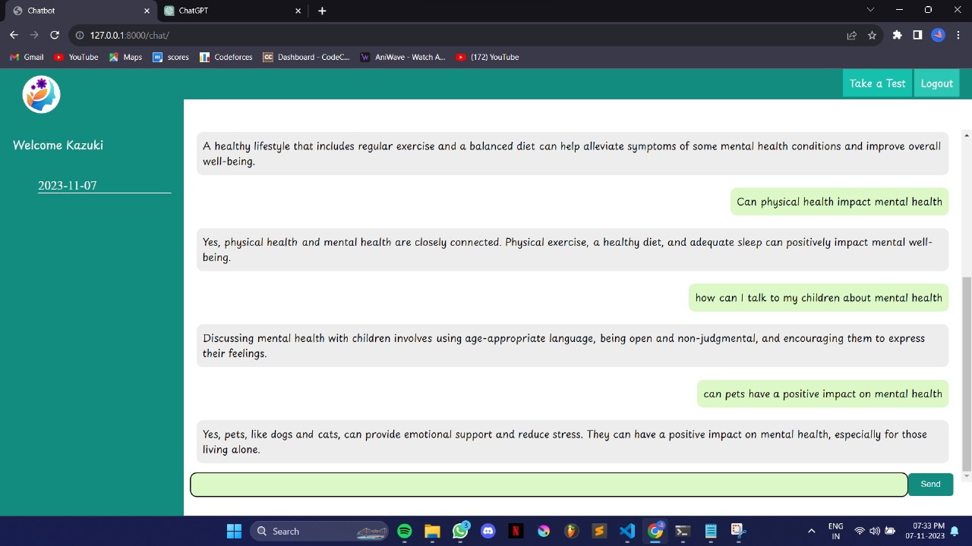
Chatbot Page
Main page displays the username, appearing as "guest user" for guest users.
Left side shows the chat history and user's username.
Users can ask mental health-related questions and receive informative responses.
Chat history includes dates, enabling users to review past conversations.
Chat history is inaccessible for guest users.

Slide 9
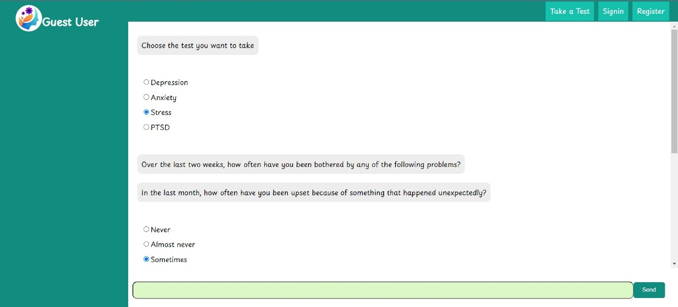
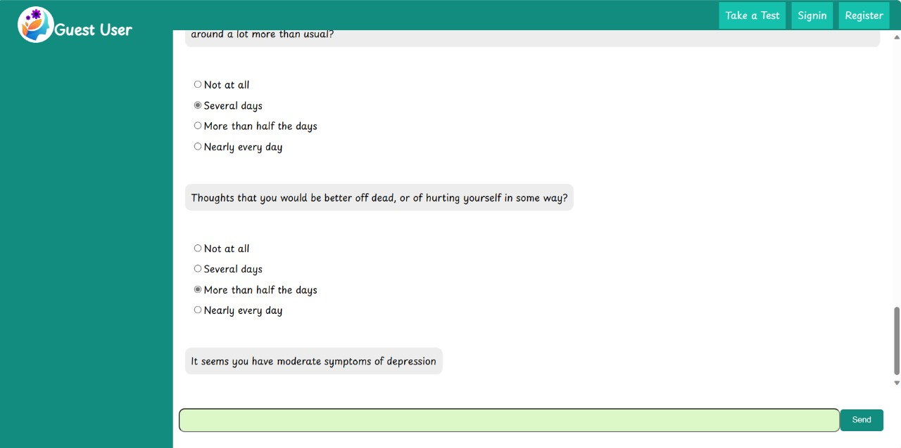
Take Test
On the Chatbot page, selecting "Take a Test" prompts the display of question options.
Four mental health options, including depression, anxiety, stress, and PTSD, are presented.
After choosing an option, the chatbot asks related questions tailored to the selected category.
The chatbot analyzes the severity of the mental health issue based on the user's responses and provides appropriate feedback.

Slide 10
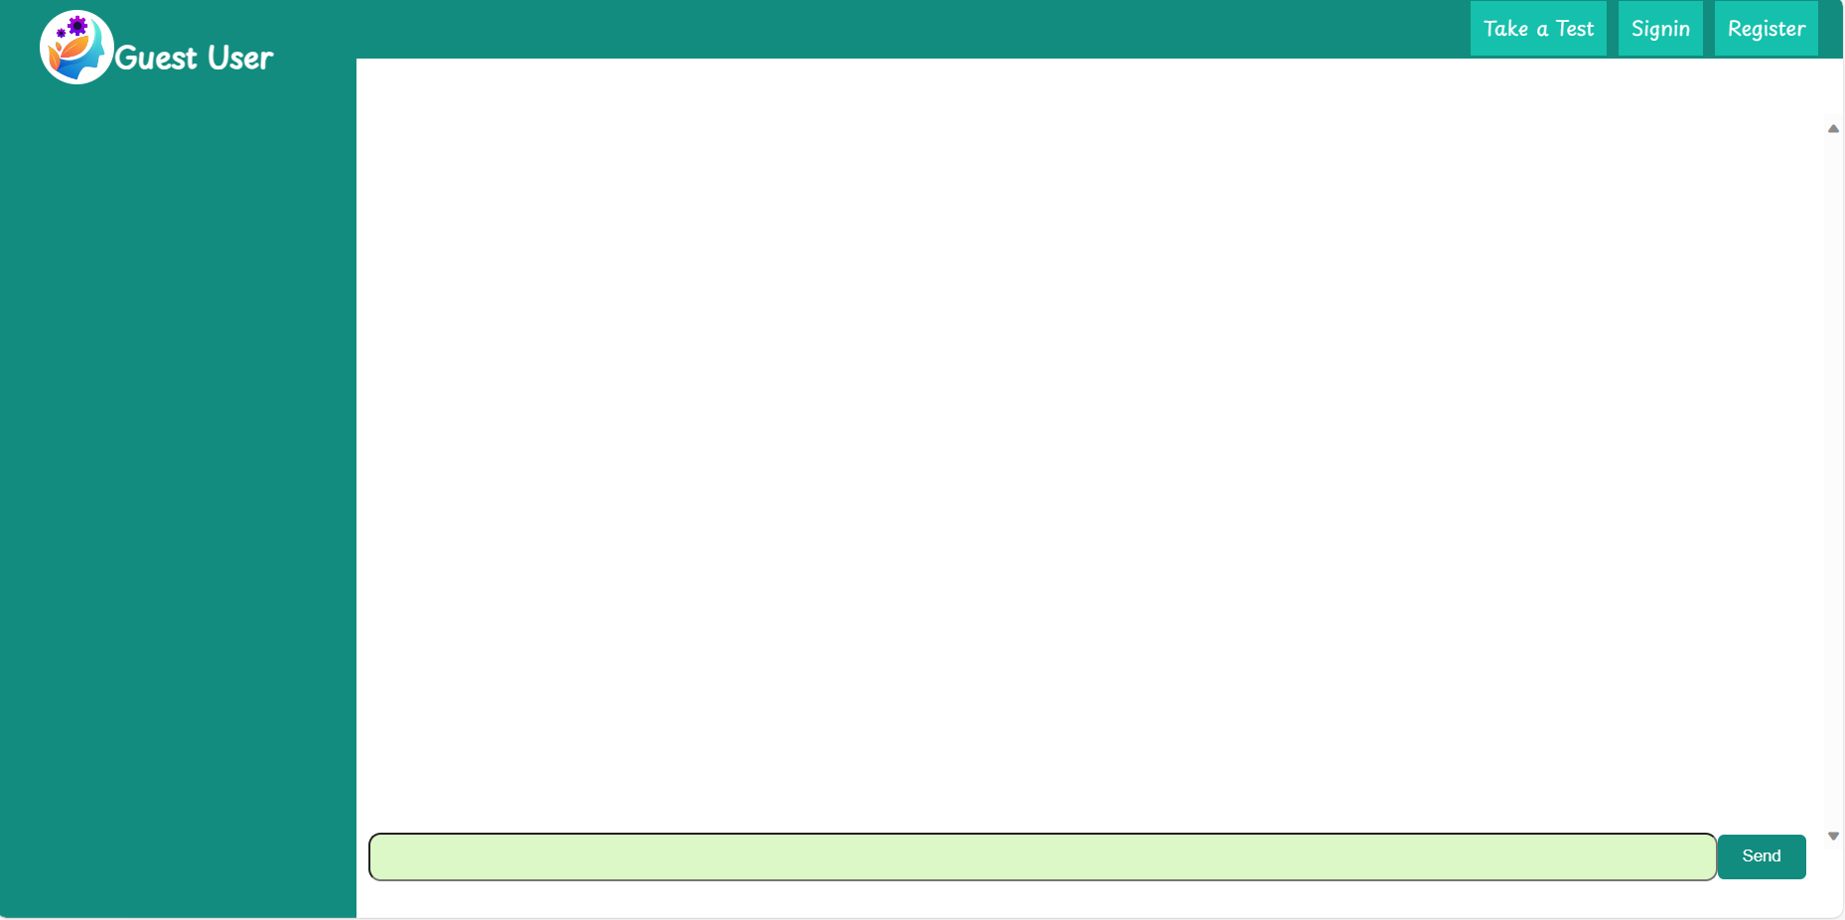
Log Out
Users can log out by clicking the "logout" option at the top right corner, as shown in the right image.
After logging out, the chat history is cleared.
The page layout is then displayed as shown in the second image, resembling the layout of the guest user page.
Notes:
Upon selecting the "logout" option situated in the upper right-hand corner, users initiate a secure disconnection from their current session. This action triggers an automatic clearance of the chat history, ensuring the protection of sensitive data and maintaining user privacy. Consequently, the system directs the user to the revamped page layout, meticulously designed to mirror the user interface of the guest user page. By adopting this standardized presentation, the system promotes a seamless and intuitive user experience, reinforcing consistency across various user interactions. This strategic alignment underscores the platform's commitment to optimizing user engagement while prioritizing data security and user interface coherence.

Slide 11
Future Scope of Project
Integration of advanced NLP for more empathetic and personalized interactions.
Expansion of mental health assessments to encompass a wider range of conditions.
Implementation of real-time data analysis for instant feedback and customized resources.
Introduction of a virtual support community to foster peer-to-peer interaction and shared experiences.
Incorporation of telemedicine features for users to connect with mental health professionals remotely.
Notes:
Advanced NLP Integration for Empathetic Interactions: The platform leverages advanced NLP to foster more empathetic and personalized user interactions, creating a supportive atmosphere for mental health discussions.
Wider Range of Mental Health Assessments: To address diverse needs, the platform expands its mental health assessments, offering users a comprehensive evaluation of various conditions.
Real-Time Data Analysis for Customized Support: Real-time data analysis enables instant feedback and tailored resources, empowering users with timely insights and personalized assistance.
Virtual Support Community for Peer Interaction: A virtual support community encourages peer-to-peer interaction, allowing users to connect, share experiences, and provide mutual encouragement.
Telemedicine Integration for Remote Mental Health Services: The integration of telemedicine features facilitates remote access to mental health professionals, ensuring convenient and accessible support for users regardless of their location.

Slide 12
Conclusion
In conclusion, our mental health chatbot offers FAQ responses, conducts tests on depression, anxiety, stress, and PTSD using established forms like PHQ-9 and GAD-7, and securely stores chat histories for registered users. User confidentiality is prioritized, as chat records are not saved for guest users. Our platform is dedicated to provide accessible and personalized mental health support, fostering a safe space for individuals to seek guidance and improve their well-being.

Slide 13
Thank you

